Slide 1
Topics
Review
Set Operators
Using set operators to combine multiple queries into a single query
Controlling the order of rows returned
Set Operator Types
Union Distinct
Union All
Intersect
Minus/Except
Set Operator Rules
Matching SELECT statement and ORDER BY with set operators

Slide 2
Subquery
What SQL SELECT clauses support subqueries?
SELECT
WHERE
HAVING
FROM

Slide 3
Subquery in SQL statements
What other statements support a subquery
CREATE
INSERT
DELETE

Slide 4
SUBQUERY TYPES
What are the general types of subqueries?
Single Row Subqueries – returns one row in the “inner” result set
Multi Row Subqueries – returns multiple rows in the “inner” result set
Multi-column Subqueries – returns multiple columns in the “inner” result set

Slide 5
Set Theory – a Mathematical construct
A {2,4,6,8,10}
B {1,2,3,4}
A ∩ B A intersect B
A ∩ B {2,4}
A U B Union of A and B
A U B {1,2,3,4,6,8,10}
Or {1,2,2,3,4,4,6,8,10}

Slide 6
Set Theory – a Mathematical construct
A {2,4,6,8,10}
B{1,2,3,4}
A - B A minus B
A - B {6,8,10}

Slide 7
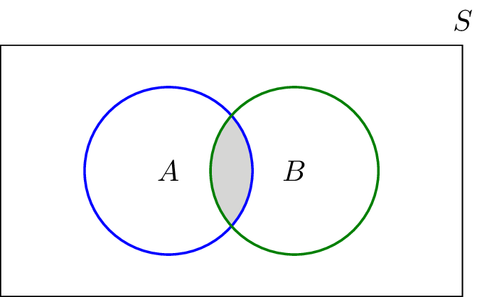
Venn Diagram for Intersection

Slide 8
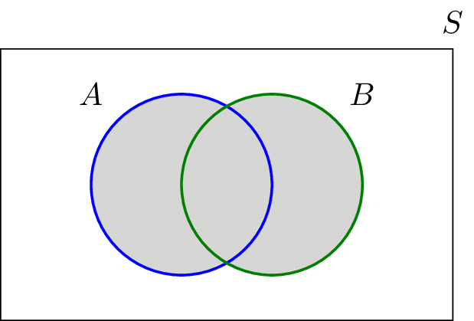
Venn Diagram for Union

Slide 9
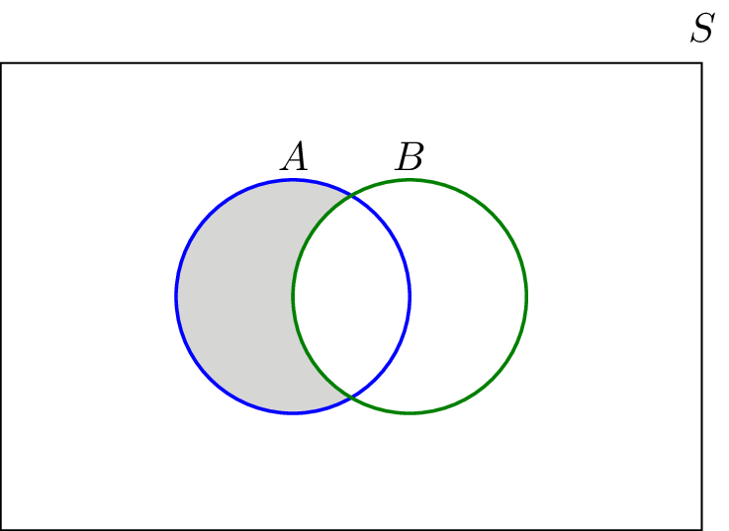
Venn Diagram for Minus / Except

Slide 10
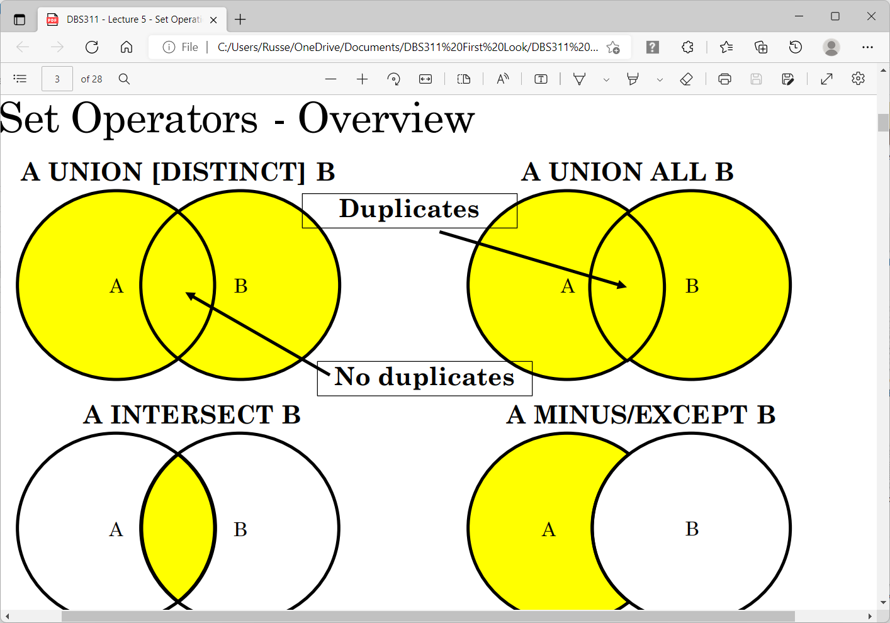

Slide 11
Set Operators
UNION – returns all rows across both tables, excluding duplicates
UNION ALL – returns all rows across both tables, including duplicates
INTERSECT – returns common rows across both tables, excluding duplicates
INTERSECT ALL – returns common rows across both tables, including duplicates
EXCEPT – returns rows unique to “LEFT” table, excluding duplicates
EXCEPT ALL – returns rows unique to “LEFT” table, including duplicates

Slide 12
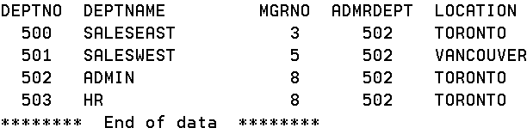
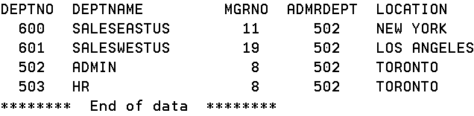
Set Operators – Data Sets
DEPT
DEPTUS

Slide 13
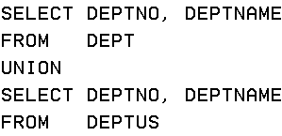
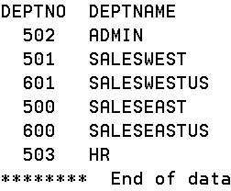
Set Operators – UNION
UNION – returns all rows across both tables, excluding duplicates

Slide 14
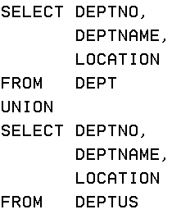
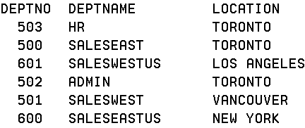
UNION – returns all rows across both tables, excluding duplicates
Same rows in result set since third column continues to match on the same rows

Slide 15
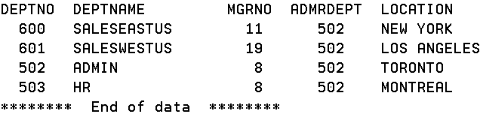
Set Operators – Data Sets
DEPT
DEPTUS (HR changed to MONTREAL)

Slide 16
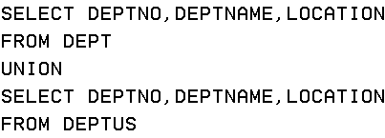
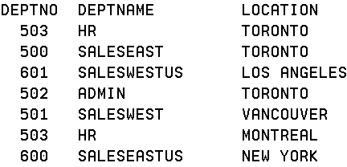
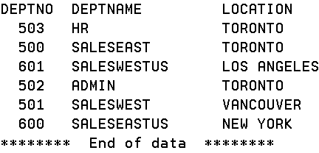
Set Operators – UNION
An additional row is included in the result set because it is no longer distinct (503 HR MONTREAL)

Slide 17
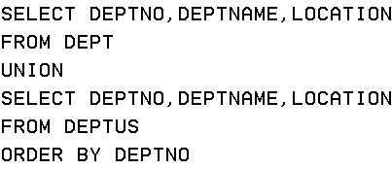
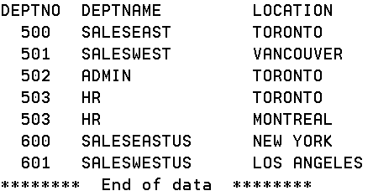
Set Operators – UNION – with ORDER BY
Use ORDER BY to organize a result set in a more readable manner

Slide 18
Set Operators – UNION – with ORDER BY
When you use UNION
Any ORDER BY clause must appear after the last subselect that is part of the union.

Slide 19
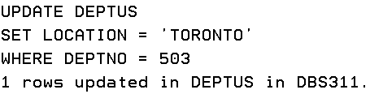
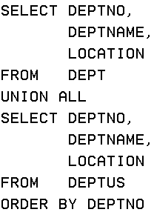
Union All
Change MONTREAL back to TORONTO
What is different with the result set now?

Slide 20
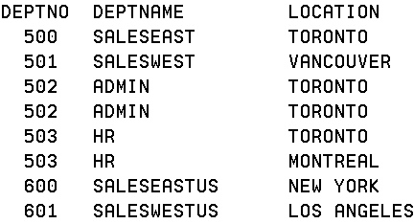
Union All
502 ADMIN TORONTO has a duplicate
503 HR TORONTO has a duplicate

Slide 21
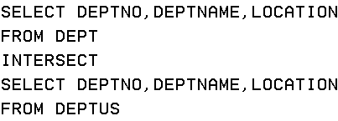
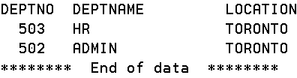
Set Operators – INTERSECT
INTERSECT – returns common rows across both tables, excluding duplicates

Slide 22
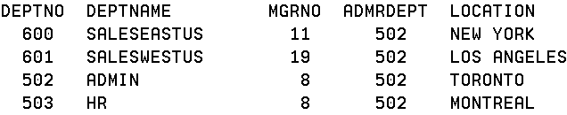

Set Operators – INTERSECT
What happens if we put MONTREAL back into DEPTUS?
Instead of

Slide 23
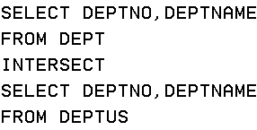
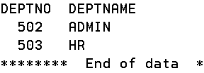
Set Operators – INTERSECT
What happens if we don’t include LOCATION in our statement?
Instead of

Slide 24

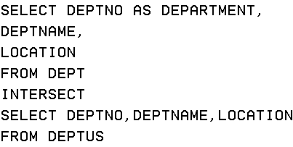
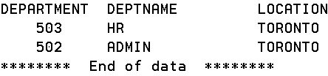
Set Operators – INTERSECT – with AS
Change MONTREAL back to TORONTO

Slide 25
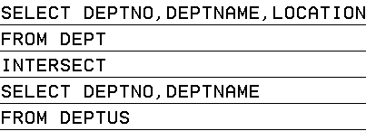
Set Operators – INTERSECT
This produces an error
For Set Operations, the columns after SELECT must be:
The same columns in each SELECT
With compatible data types
If data types are different, you may need to CAST

Slide 26
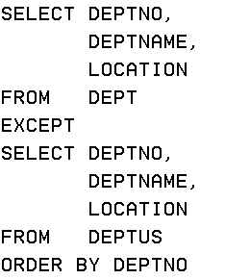

Set Operators – EXCEPT / MINUS
EXCEPT – returns rows unique to “LEFT” table, excluding duplicates

Slide 27
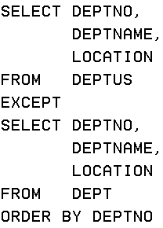
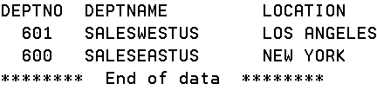
Set Operators – EXCEPT / MINUS
EXCEPT – CHANGE ORDER OF TABLES

Slide 28
Sets vs Joins
JOINS are about COMBINING the records from two different tables (or objects) where there is some common connection between the two.
Example: EMPLOYEE table and SALARY table. Both have employee number and name in common, but, one table focuses on one set of attributes about the employee (like personal information such as phone, address, years of service, etc.) – and – the other focuses on a different set of attributes about the employee (like department, salary, commission, etc).

Slide 29
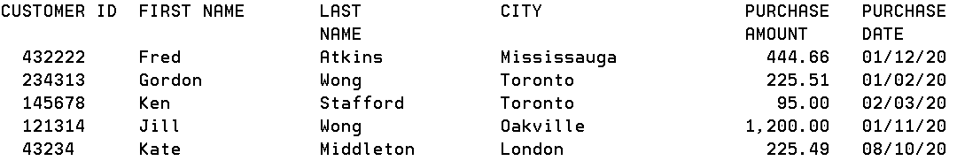
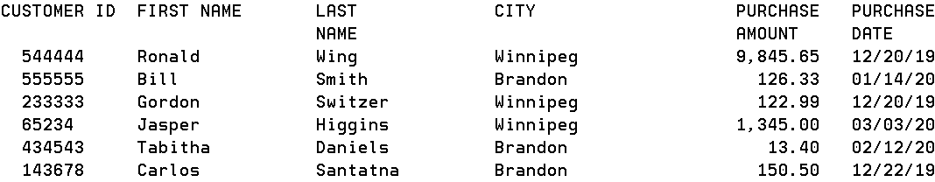
Ontario and Manitoba
Ontario
Manitoba

Slide 30
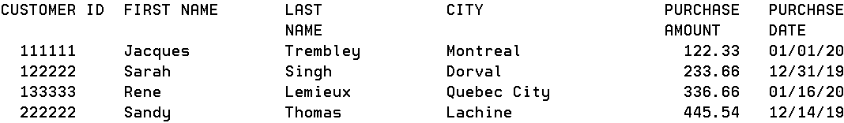
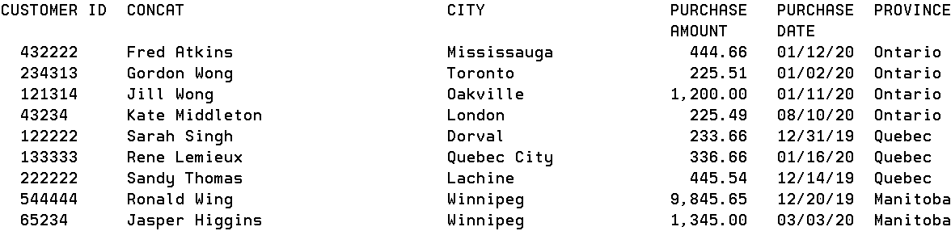
Quebec and all tables
Quebec
Customers from the 3 tables spending more than $200

Slide 31
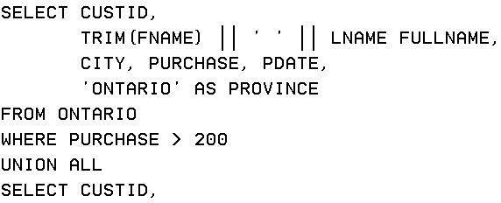
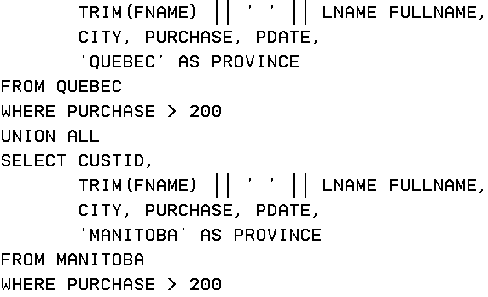
Union All for 3 Tables

Slide 32
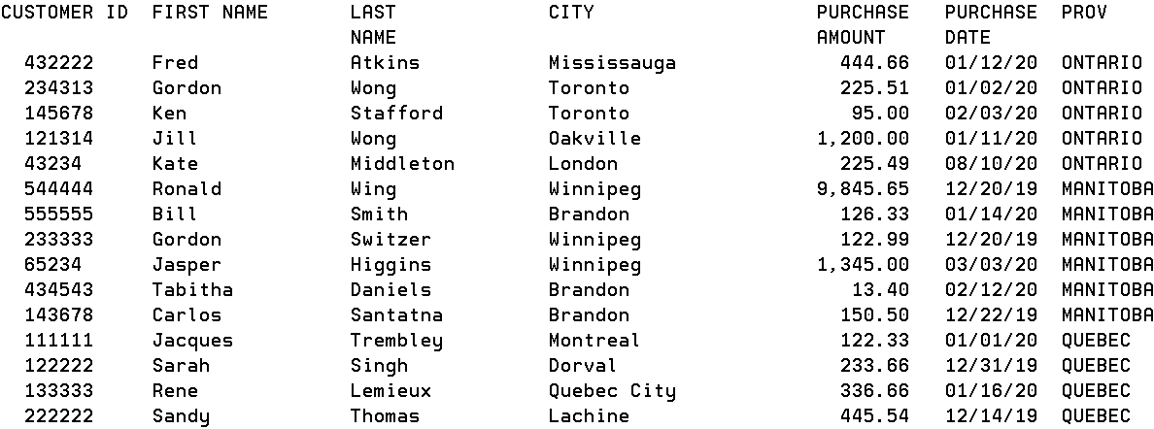
Provinces
Produce a table with all the provinces
Provinces

Slide 33

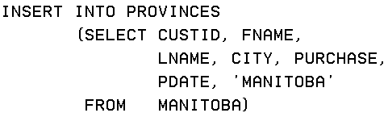
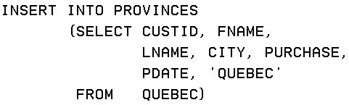
PROVINCES

Slide 34

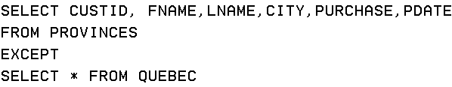

Slide 35
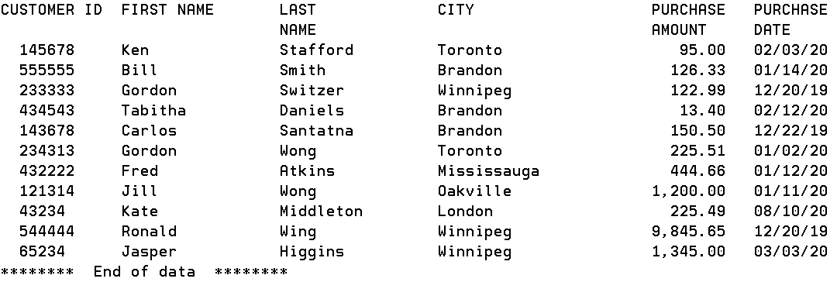
Without the province name

Slide 36
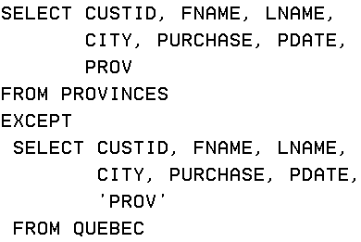
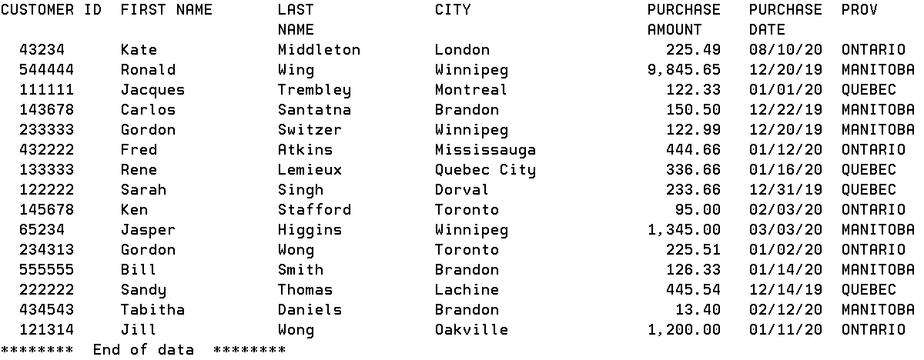
Including the province
Does this work?

Slide 37
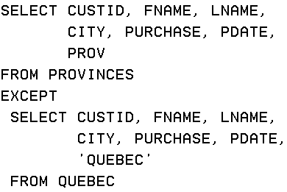
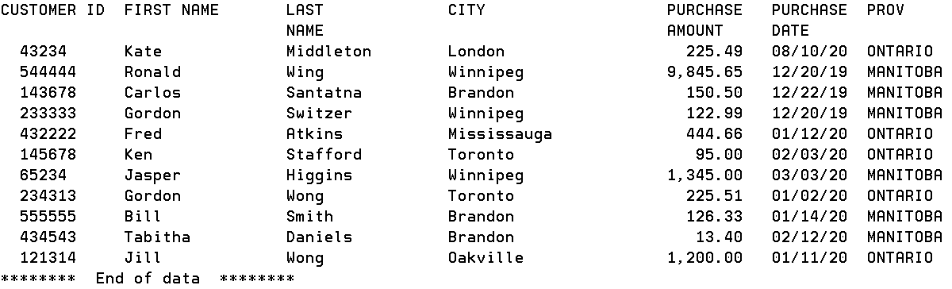
Excluding the province QUEBEC
How do you exclude QUEBEC?

Slide 38
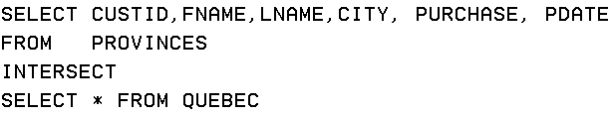
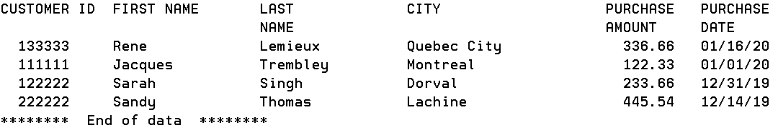

INTERSECT

Slide 39
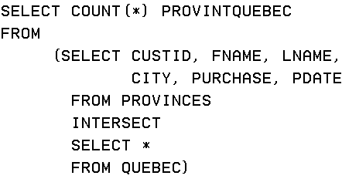
INTERSECT

Slide 40
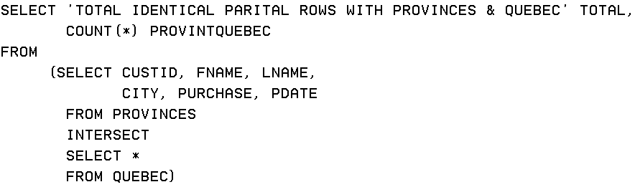
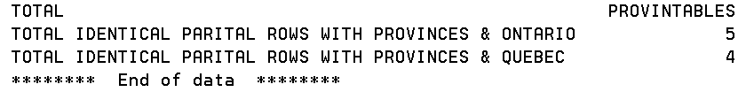

Slide 41


Slide 42
Thousands of customers and hundreds of employees.
Are any of our employees listed as customer contacts?

Slide 43

CUSTOMERS

Slide 44

EMPLOYEES

Slide 45


COMMON NAMES

Slide 46


Phone the employee and ask

Slide 47
Set Operators – Additional Guidelines
You must match the data type when columns do not exist in one or the other table
You can use various functions like CAST, TO_CHAR or any other conversion function to ensure data types match
SELECT department_id,
TO_NUMBER (null) as location,
hire_date
FROM employees
UNION
SELECT department_id,
location_id,
TO_DATE (null)
FROM departments;

Slide 48
Set Operators – Additional Guidelines
when columns do not exist in one or the other table
SELECT employee_id,
job_id, salary
FROM employees
UNION
SELECT employee_id,
job_id,
0
FROM job_history;

Slide 49
Set Operators – Additional Guidelines
The expressions in the SELECT lists must match in number.
If you select 3 columns in A, then must have 3 columns in B
The data type of each column in the second query must match the data type of its corresponding column in the first query.
Parentheses can be used to alter the sequence of execution.
ORDER BY clause can appear only at the very end of the statement.
Duplicate rows are automatically eliminated except in UNION ALL.
Column names from the first query are the ones that appear in the result.
The output is sorted in ascending order by default except in UNION ALL

Slide 50

DB2 GUI

Slide 51

DB2 GUI
In purchase amount order?

Slide 52
Lab 4
Lab 4 is posted.
Lab 4 will be an online lab

